Slide 1
Risk-Sensitive Extended Kalman Filter
Armand Jordana, et al.
IEEE International Conference on Robotics and Automation (ICRA), 2024
Shalini Agrawal
Algorithms:
Risk-Sensitive Extended Kalman Filter
Differential Dynamic Programming (DDP) - MPC
Implemented on:
1. Unicycle with friction uncertainty
2. Planar quadrotor carrying an unknown load (research paper)

Slide 2
PROCESS OVERVIEW
Risk-Sensitive
EKF
Measurements (y)
Control Input (u_{t-1})
Value Function
Vx, Vxx
Robot
Risk-Sensitive Estimate x_{RS}(t)
Sensor
Measurements
Control Input
(u_{t})
Model Predictive Control
DDP
States (x)

Slide 3
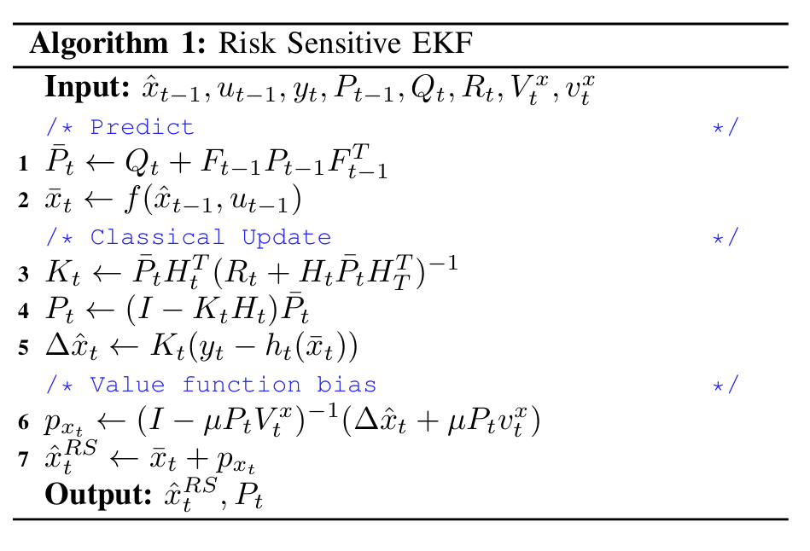
ALGORITHM
RS-EKF
Differential Dynamic Programming
RS-EKF
Initialize Control Sequence
Prediction step
Classical EKF update
Risk-sensitive correction (value function bias)
1st Rollout: Trajectory + Cost
Optimization
Backward Pass: Vx, Vxx, Gains
Check for convergence
Not Converged
Forward Pass with line search
Converged
Cost Improved
No
Yes
Return Optimal Trajectory + Controls
Update Control Sequence
Risk-sensitivity parameter

Slide 4
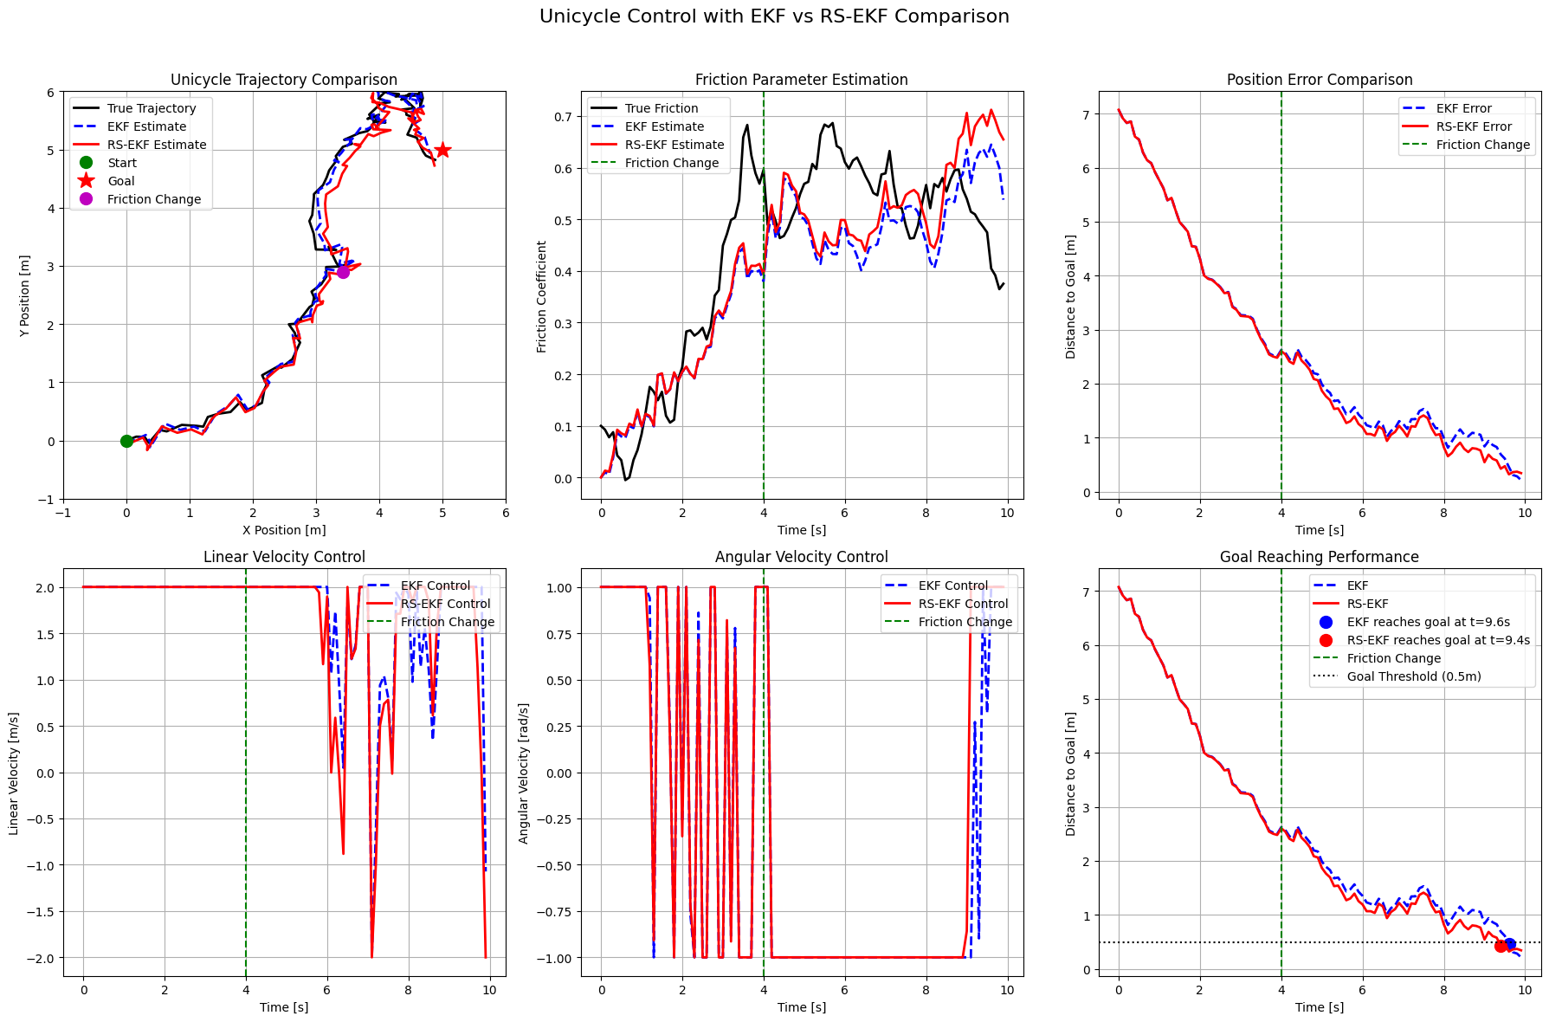
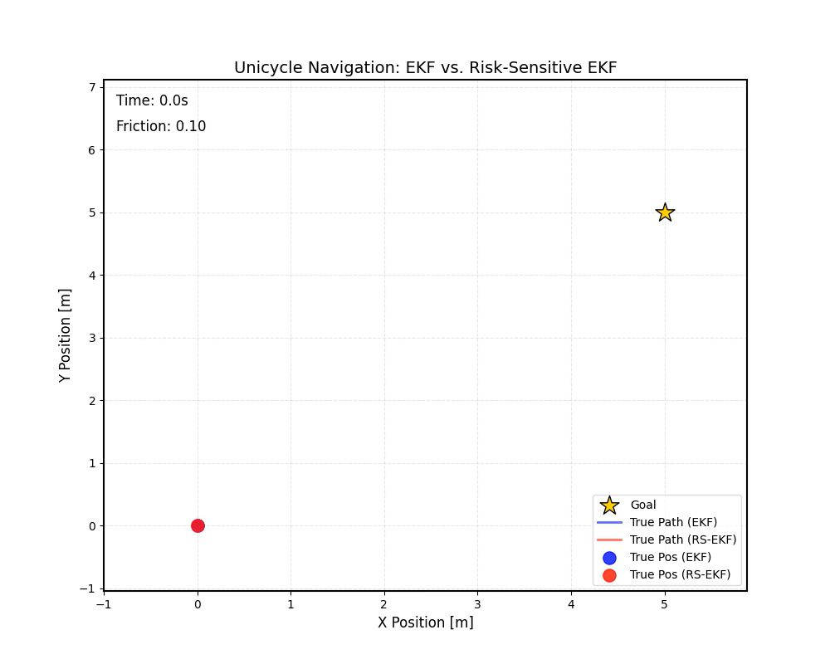
RESULTS
Unicycle with friction uncertainty
Implementation

Slide 5
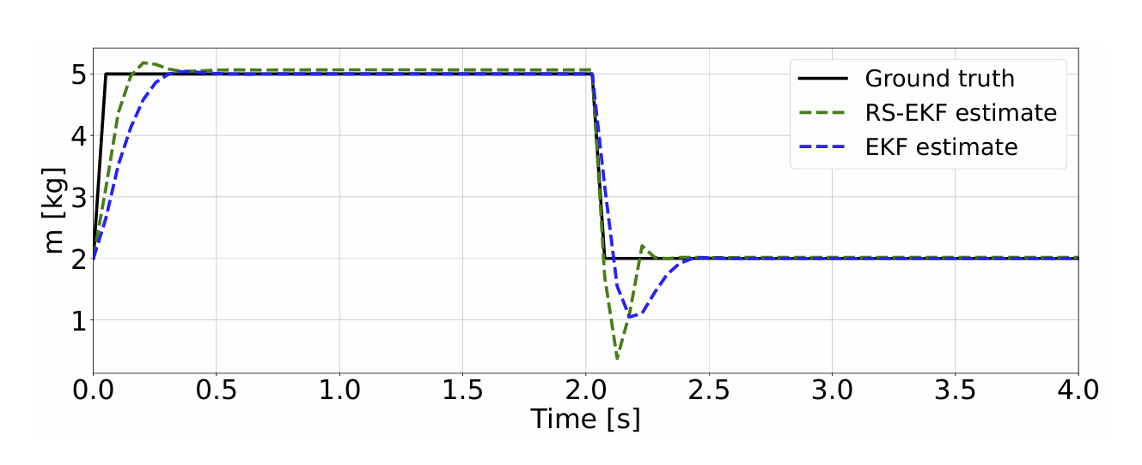
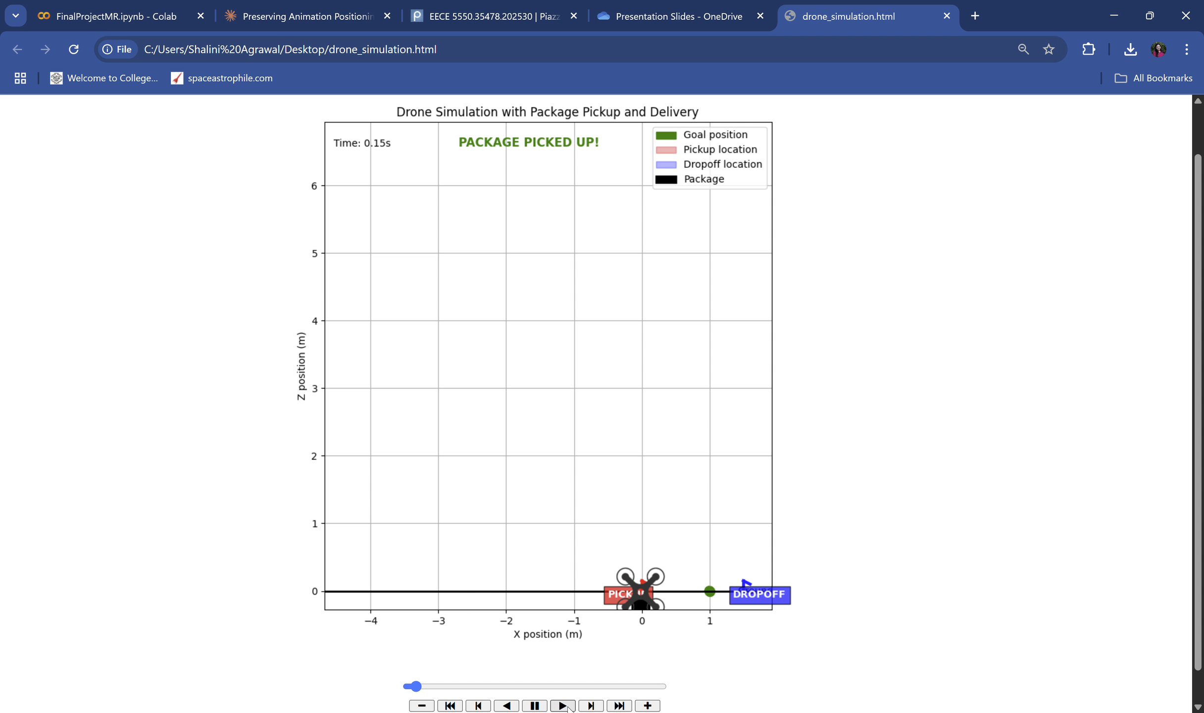
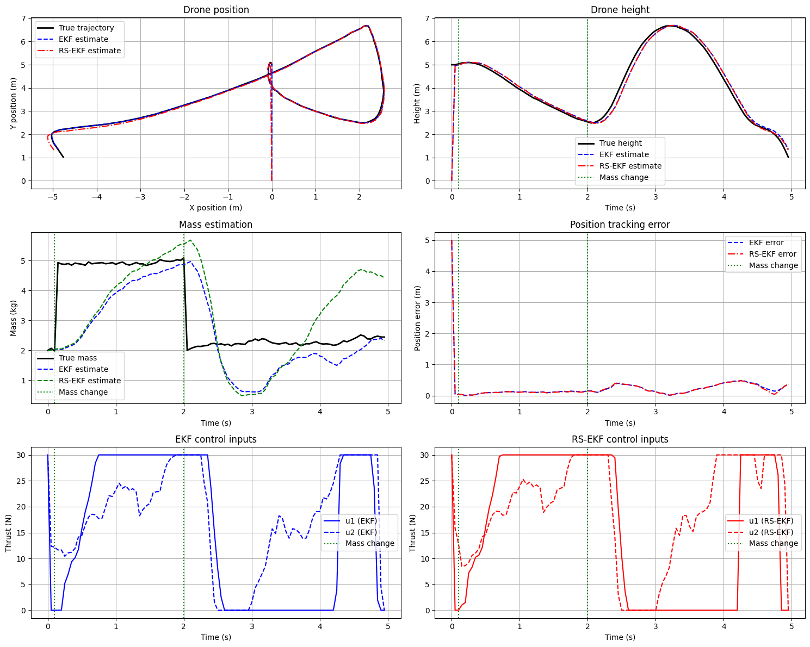
RESULTS
Planar quadrotor carrying an unknown load
Performance metrics:
EKF position MSE: 0.151105
RS-EKF position MSE: 0.142447
Position Improvement: 5.7%
Average cost along trajectory:
EKF cost: 42.0856
RS-EKF cost: 40.5705
Cost improvement: 3.6%

Slide 6
THANK YOU!

